Slide 1

From Casual User to Member
Cyclistic Bike-Share Case Study
Prepared by: Aidana Bàez
Created on: February 9, 2024
Purpose: Google Career Certificate Capstone

Slide 2
Executive Summary
Data Sources
Summary of Analysis
Top Three Recommendations
References
Table
of Contents

Slide 3
Executive
Summary
Overview:
  Cyclistic boasts 5,800+ bicycles and 600 docking stations, differentiating itself with inclusive options like reclining bikes, hand tricycles, and cargo bikes for people with disabilities and those unable to use standard bikes.
  Traditional bikes are the preferred choice, with assistive options utilized by 8% of riders.
  Usage split: 70% leisure, 30% commuting, with peak usage at 5 pm.
Data Insights:
  Casual users constitute 35% of rides in 2023.
  Both user types prefer classic bikes, with casual riders favoring weekends and members commuting during work hours.
  Peak usage at 5 pm, longer ride lengths for casual users, and increased activity during Q2 and Q3, peaking in August.
  Significant usage area overlap; top starting stations near Chicago Harbor and recreational points.
    Top Routes:
      Casual members: DuSable Lake Shore Dr & Monroe St to DuSable Lake Shore Dr & Monroe St.
      Members: Ellis Ave & 60th St to University Ave & 57th St.
Recommendations:
1. Seasonal Promotional Campaign: - Launch targeted promotions for casual riders from Spring to Summer, - Introduce a "Distance Ridden Contest" during peak casual bike usage months, - Organize a biking event in August to capitalize on heightened usage and warm weather.
2. Health and Fitness Collaboration: - Partner with local health and fitness influencers to promote biking's health benefits, - Align promotional efforts with health and activity preferences of casual users,
3. Customized Member Packages and Scavenger Hunt: - Develop Cylistic member packages for leisure and weekends, - Implement an interactive scavenger hunt near bike stations to engage users and promote annual memberships.
Conclusion:
Leveraging the insights from this analysis, Cyclistic can strategically tailor promotions, engage influencers, and enhance member offerings to further differentiate itself and meet the diverse needs of both casual and annual users.

Slide 4

Data Sources
Cyclistic Bike-Share Trip Data
Period of data used January 2023 - December 2023
Data License Information
Prepared Data Used in Analysis
Final 2023 Trip Data Cleaned

Slide 5
Problem and
Task
Problem:
Business Task:
Design marketing strategies aimed at converting Cyclistic’s casual riders into annual members.
Analyze historical bike trip data to identify trends in how annual members and casual riders use Cyclistic bikes differently.

Slide 6
How do annual members and casual riders use Cyclistic bikes differently?
Analysis Dashboard
Cyclistic Bike Share Case Study – Google Looker Studio
Cyclistic Bike Share Case Study - Tableau
*Due to exporting limitations, Tableau dataset is limited to 30k rides, while Google Looker Studio dataset presents analysis from 4m rides

Slide 7
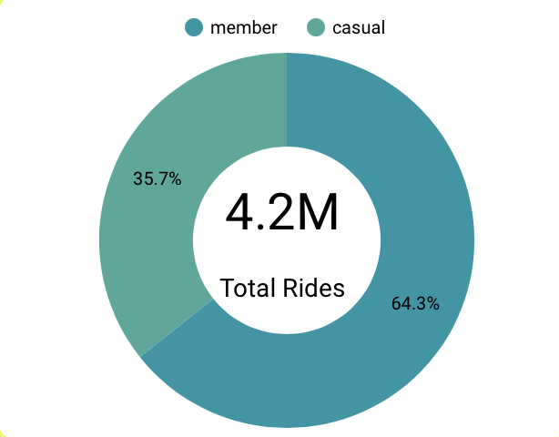
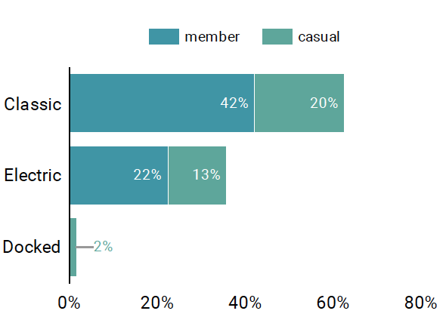
Casual users currently make up 35% of the rides in 2023.
Casual users as well as Cyclistic members prefer to use classic bikes.
Source: Google Looker Studio

Slide 8
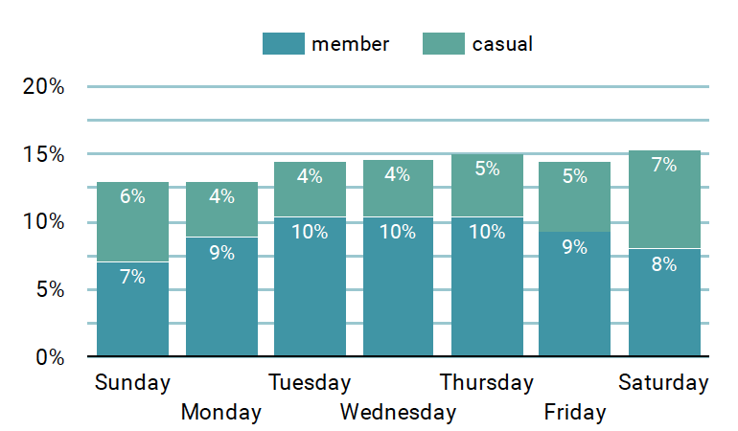
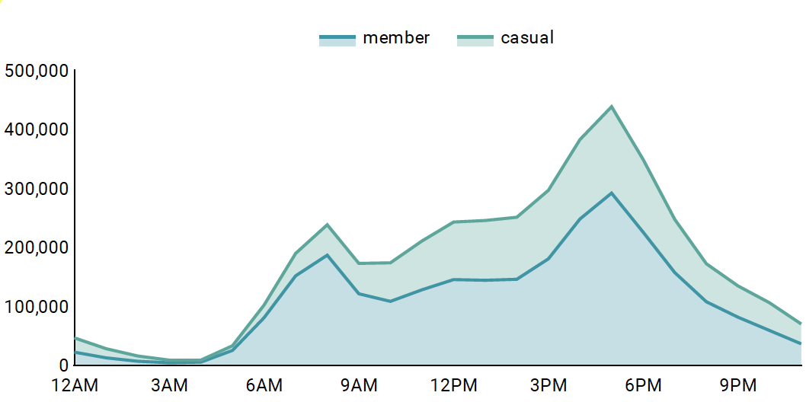
Casual prefer the weekends, while Cyclistic members like to use the service for work time commute.
5 pm is peak time for both user types
Source: Google Looker Studio

Slide 9
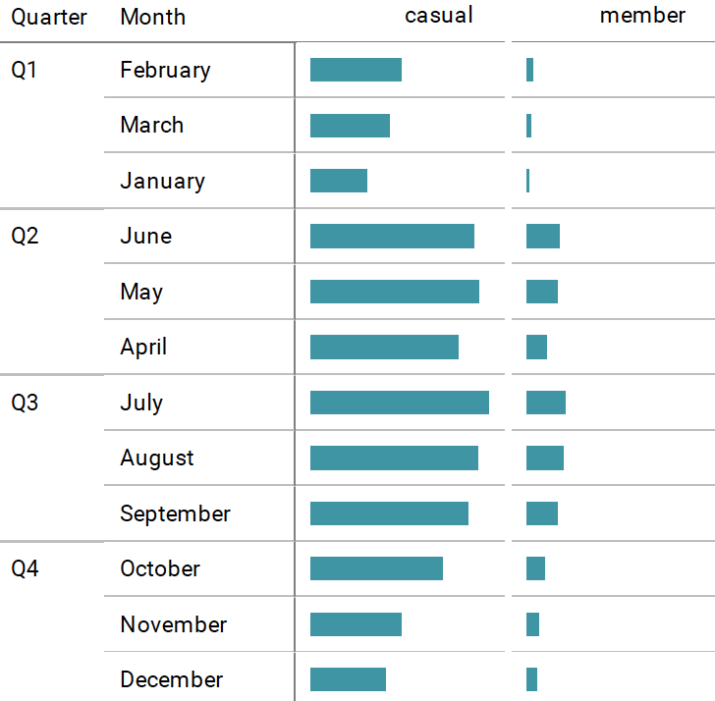
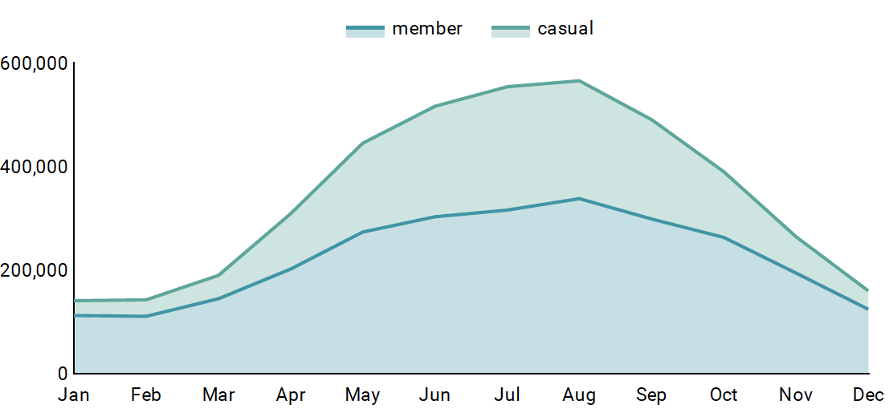
Casual users have longther ride length times
Casual users increase their use during the 2nd nd third quarter peaking in august.
Source: Google Looker Studio

Slide 10
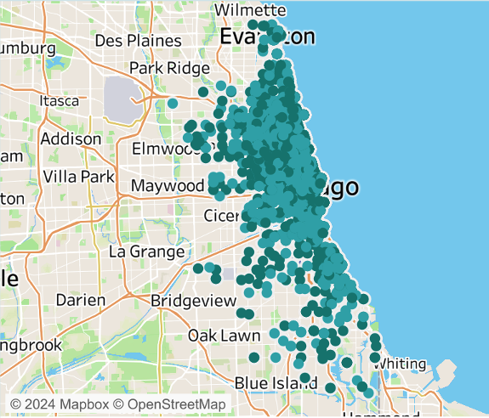
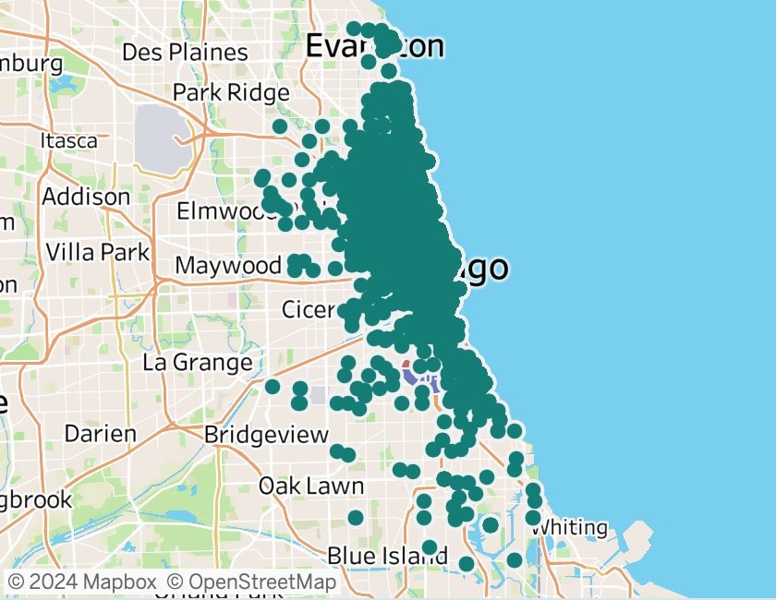
Usage area for both groups overlap significantly
Casual users use Cyclistic bikes throughout the available area
Source: Tableau *Due to exporting limitations, Tableau dataset is limited to 30k rides, while Google Looker Studio dataset presents analysis from 4m rides

Slide 11
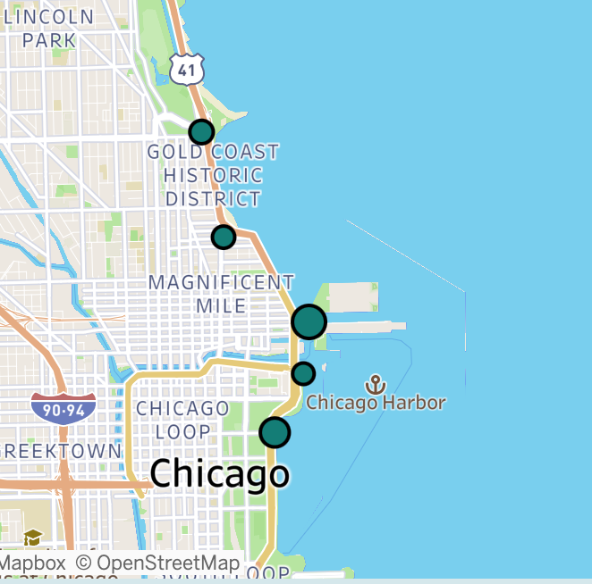
DuSable Lake Shore Dr & North Blvd
These are the top 5 starting stations
Michigan Ave & Oak St
Streeter Dr & Grand Ave
Dusable Harbor
DuSable Lake Shore Dr & Monroe St

Slide 12
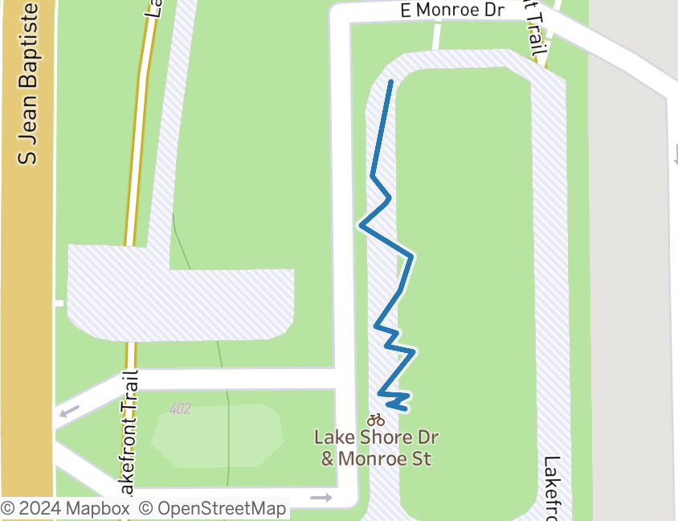
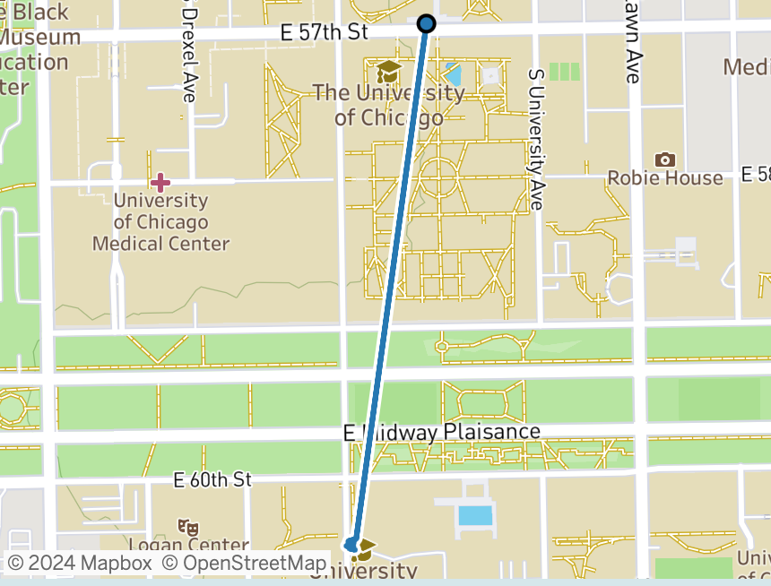
The most used route for casual members is DuSable Lake Shore Dr & Monroe St to DuSable Lake Shore Dr & Monroe St, which suggests users begin and end their rides at the same location
The most used route for casual members is Ellis Ave & 60th St_University Ave & 57th St, which suggests Cyclistic members utilize the bikes
Source: Tableau *Due to exporting limitations, Tableau dataset is limited to 30k rides, while Google Looker Studio dataset presents analysis from 4m rides

Slide 13
What is the data telling us about how we can covert casual users into Cyclistic Members?

Slide 14
Recommendation
1
Trend:
The surge in demand from casual riders during the Spring and Summer seasons presents a favorable window for strategically timed advertising campaigns and promotional initiatives.
Proposal:
Commence a promotional campaign targeting casual riders at the onset of Spring, and continue it through the entirety of Summer.
Launch a compelling promotional campaign centered around a "Distance Ridden Contest" during the peak months of increased casual bike usage. Encourage users to log their biking activities through the Cylistic app, tracking and rewarding riders covering the longest distances. This not only promotes physical activity but also fosters a sense of community and healthy competition.
Leverage the heightened bike usage and warm weather in August by organizing a dedicated biking event. This event could include group rides, fitness challenges, and informational sessions on the health benefits of regular biking. Partner with local fitness experts or health organizations to add credibility and attract a broader audience.

Slide 15
Recommendation
2
Trend:
Casual users tend to cover greater distances when utilizing the bikes compared to annual members.
Proposal:
Collaborate with Local Health and Fitness Influencers:
Partner with local health and fitness influencers to endorse the health benefits of biking. Arrange sponsored content, fitness challenges, or joint events to amplify the message and attract a broader audience.
By aligning our promotional efforts with the health and activity preferences of casual users, we aim to not only enhance their biking experience but also foster long-term commitment through annual memberships.

Slide 16
Recommendation
3
Trend:
Cyclistic members predominantly utilize bikes for their daily commute to work, displaying steady activity levels during weekdays.
On the other hand, casual riders employ bikes for weekend leisure, showcasing increased activity and extended ride durations on weekends.
Proposal:
Develop customized Cylistic member packages specifically designed for leisure and weekend pursuits. Employ various digital marketing channels to effectively promote these tailored membership offerings. Potential package features may encompass curated entertainment pairings, discounted weekend rates, or location-based pricing structures.
Implement an interactive scavenger hunt, strategically placing clues at or near established bike stations. Participants, predominantly casual users, can engage in the hunt, fostering familiarity with the station network. As an incentive, offer exclusive discounts or perks for annual membership sign-ups upon successful completion of the scavenger hunt. This not only adds an element of fun but also serves as a direct conversion opportunity.

Slide 17
References
Google Looker Studio Dashboard : Cyclistic Bike Share Case Study
Tableau Public Dashboard: Cyclistic Bike Share Case Study
GitHub Repository: Cyclistic-Analysis-Case-Study
Portfolio: Aidana Baez

